Slide 1

Evolution of synoptic patterns associated with north wind episodes (tramuntana) in northeastern Catalonia throughout the 21st century
Marc Prohom and Juan Carlos Peña marc.prohom@gencat.cat
8th MedMet Conference – 25th May 2021

Slide 2
The CLIMAVIT 21 project
General Objectives:
Provide objective data on climate and water needs for the adaptation of viticulture to climate change throughout the 21st century. It was a joint initiative of IRTA (Institute of Agrifood Research and Technology) and the SMC (Meteorological Service of Catalonia)
Specific objective:
Climate projections, meteorological indices and water needs until the end of the 21st century for wine production areas of the DO Pla de Bages and Empordà
Evapotranspiration: Temperature + Irradiation + Wind
Tramuntana

Slide 3
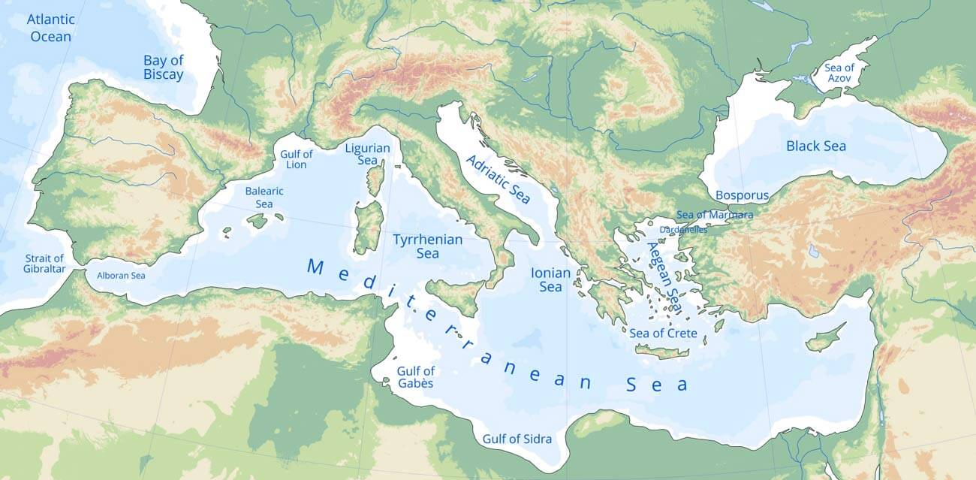
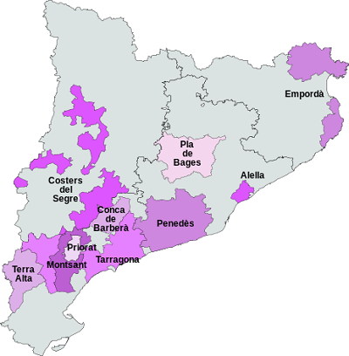
The CLIMAVIT 21 project
Designation of Origin (DO)
regions

Slide 4
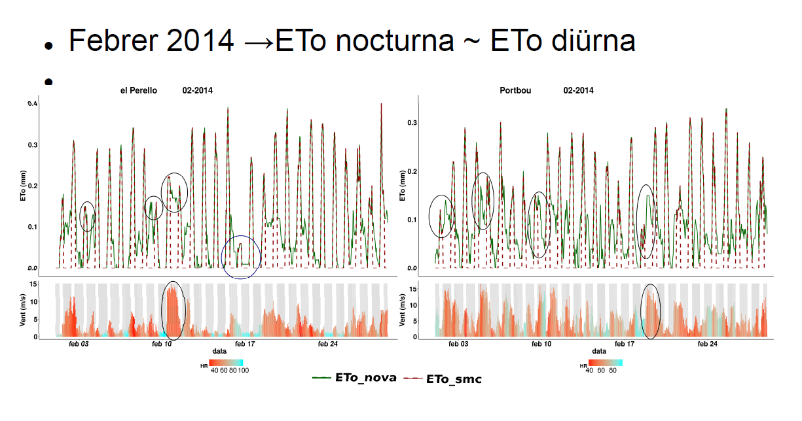
Why analyze the Tramuntana?
Source: Vicent Altava (SMC)

Slide 5
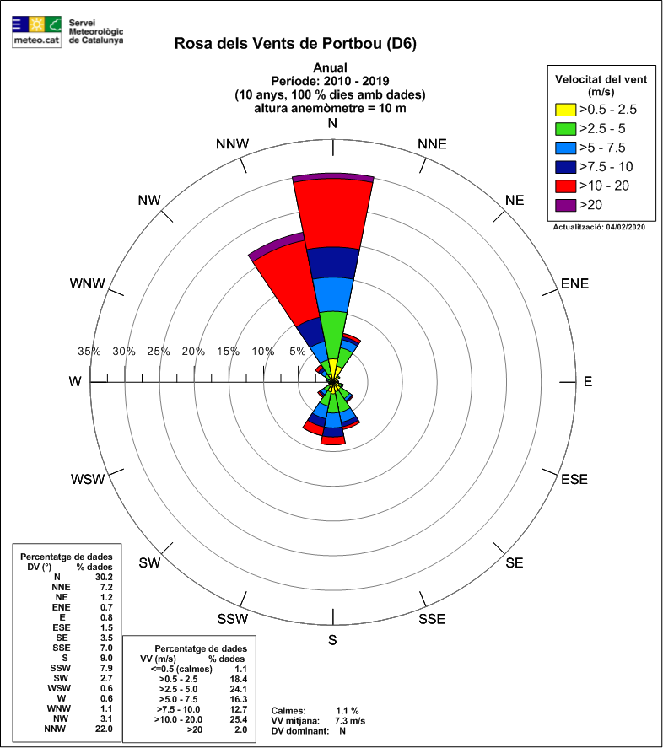
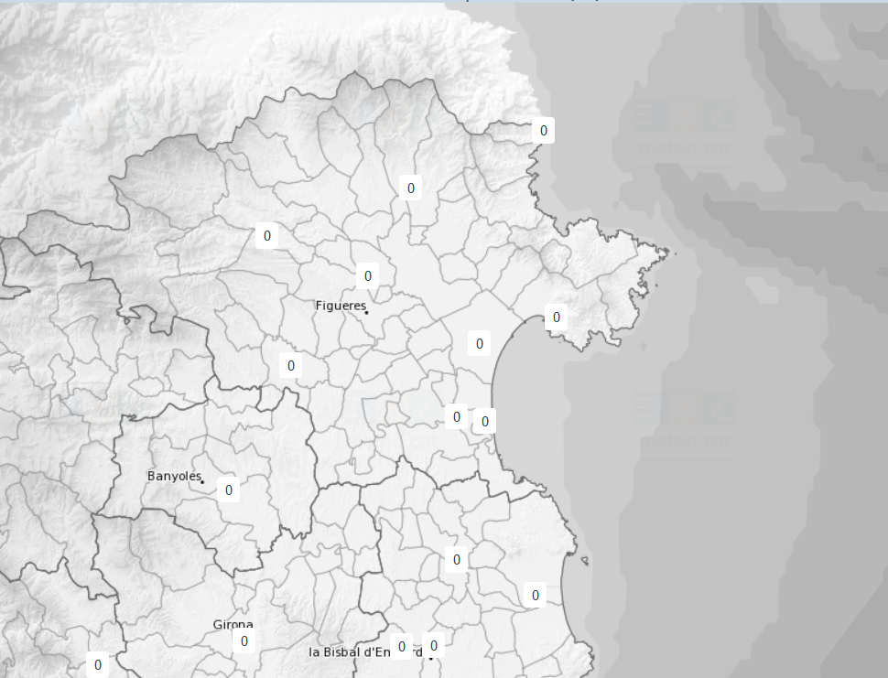
1. Identification of tramuntana episodes (1998-2019)
Portbou
Cabanes
Portbou sentinel station:
0 ≥ WD ≤ 22.5 o r 320 ≥ WD ≤ 360
Wx > 90 km/h
Cabanes identifier of the episodes:
Same filters
Coincident days
Portbou and Cabanes (1998-2019)
384 episodes

Slide 6
1. Identification of tramuntana episodes (1998-2019)
Data sources:
Sea Level Pressure - NCEP/NCAR database.
Domain: 40W - 40E / 20N - 70N.
Grid resolution: 2.5º
Methodology
Reduction of variables: Principal Component Analysis (PCA) applied to the corrected SLP anomalies
Determination of synoptic patterns: Cluster Analysis (AC) based on PCA scores
4 synoptic patterns

Slide 7
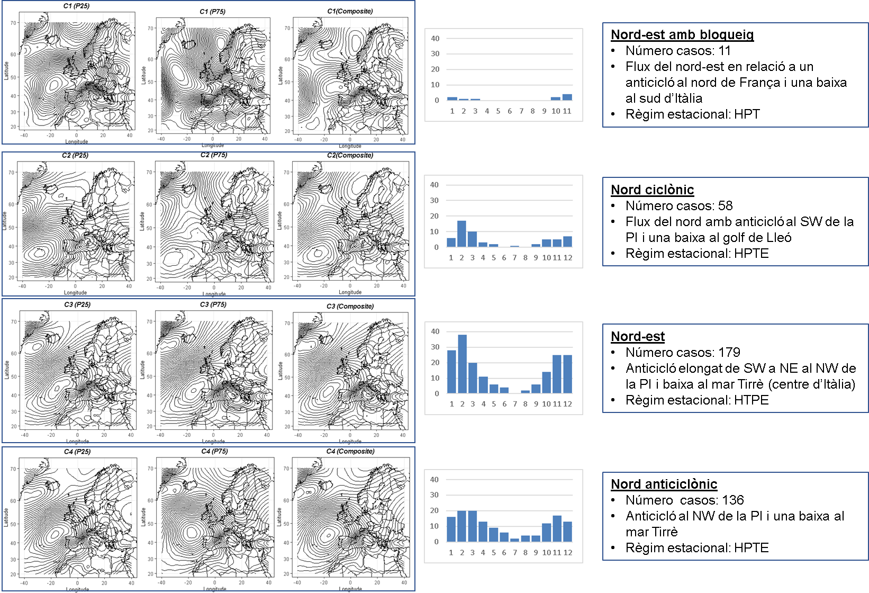
1. Identification of tramuntana episodes (1998-2019)

Slide 8
2. Projection of tramuntana patterns (2006-2100)
Data sources:
Period:2006-2100
Climate Model Intercomparison Project (CMIP5): 9 models (Wv and SLP)
Methodology:
Episodes identification:
Days when the 90th percentile of WV series is exceeded in each of the models
Future north wind synoptic patterns
Principal Component Analysis (PCA) to reduce variable + Cluster Analysis (CA) to determine synoptic patterns
Projections and simulations:
Regression model (dependent variable: historical series / independent variables: simulation) + identification of the 2 best simulations

Slide 9
2. Projection of tramuntana patterns (2006-2100)
Model name | Modelling centre | Model details
ACCESS1.3 | CSIRO (Commonwealth Scientific and Industrial Research Organisation, Australia), and BOM (Bureau of Meteorology, Australia) | ACCESS1-3 2011. Atmosphere: AGCM v1.0 (N96 grid-point, 1.875 degrees EW x approx. 1.25 degree NS, 38 levels); ocean: NOAA/GFDL MOM4p1 (nominal 1.0 degree EW x 1.0 degrees NS, tripolar north of 65N, equatorial refinement to 1/3 degree from 10S to 10 N, cosine dependent NS south of 25S, 50 levels); sea ice: CICE4.1 (nominal 1.0 degree EW x 1.0 degrees NS, tripolar north of 65N, equatorial refinement to 1/3 degree from 10S to 10 N, cosine dependent NS south of 25S); land: CABLE1.0 (1.875 degree EW x 1.25 degree NS, 6 levels;
BNU-ESM | GCESS,BNU,Beijing,China | BNU-ESM;
CNRM-CM5 | CNRM (Centre National de Recherches Meteorologiques, Meteo-France, Toulouse,France) and CERFACS (Centre Europeen de Recherches et de Formation Avancee en Calcul Scientifique, Toulouse, France) | CNRM-CM5 2010 Atmosphere: ARPEGE-Climat (V5.2.1, TL127L31); Ocean: NEMO (nemo3.3.v10.6.6P, ORCA1degL42); Sea Ice: GELATO (V5.30); River Routing: TRIP (v1); Land: SURFEX (v5.1.c); Coupler : OASIS 3;
GFDL-CM3 | NOAA GFDL(201 Forrestal Rd, Princeton, NJ, 08540) | GFDL-CM3 2010 atmosphere: AM3 (AM3p9,C48L48); sea ice: SIS (SISp2,Tripolar360x200); land: LM3 (LM3p7_cCM3,C48); ocean: MOM4 (MOM4p1_x1_Z50_cCM3,Tripolar360x200L50);
GFDL-ESM2G | NOAA GFDL(201 Forrestal Rd, Princeton, NJ, 08540) | GFDL-ESM2G 2010 ocean: TOPAZ (TOPAZ1p2,Tripolar360x210L63); atmosphere: AM2 (AM2p14,M45L24); sea ice: SIS (SISp2,Tripolar360x210L63); land: LM3 (LM3p7_cESM,M45);
GFDL-ESM2M | NOAA GFDL(201 Forrestal Rd, Princeton, NJ, 08540) | GFDL-ESM2M 2010 ocean: MOM4 (MOM4p1_x1_Z50_cCM2M,Tripolar360x200L50); atmosphere: AM2 (AM2p14,M45L24); sea ice: SIS (SISp2,Tripolar360x200L50); land: LM3 (LM3p7_cESM,M45) Computing resources were provided by the Climate Simulation Laboratory at the NCAR Computational and Information Systems Laboratory (CISL),\n,;
HadGEM2-CC | Met Office Hadley Centre, Fitzroy Road, Exeter, Devon, EX1 3PB, UK, (http://www.metoffice.gov.uk) | HadGEM2-CC (2011) atmosphere: HadGAM2(N96L60); ocean: HadGOM2 (lat: 1.0-0.3 lon: 1.0 L40); land-surface/vegetation: MOSES2 and TRIFFID; ocean biogeochemistry: diat-HadOCC;
IPSL-CM5A-MR | IPSL (Institut Pierre Simon Laplace, Paris, France) | IPSL-CM5A-MR (2010) : atmos : LMDZ4 (LMDZ4_v5, 144x143x39); ocean : ORCA2 (NEMOV2_3, 2x2L31); seaIce : LIM2 (NEMOV2_3); ocnBgchem : PISCES (NEMOV2_3); land : ORCHIDEE (orchidee_1_9_4_AR5);
MPI-ESM-MR | Max Planck Institute for Meteorology | MPI-ESM-MR 2011; URL: https://www.mpimet.mpg.de/en/science/models/mpi-esm/; atmosphere: ECHAM6 (REV: 4968), T63L47; land: JSBACH (REV: 4968);;

Slide 10
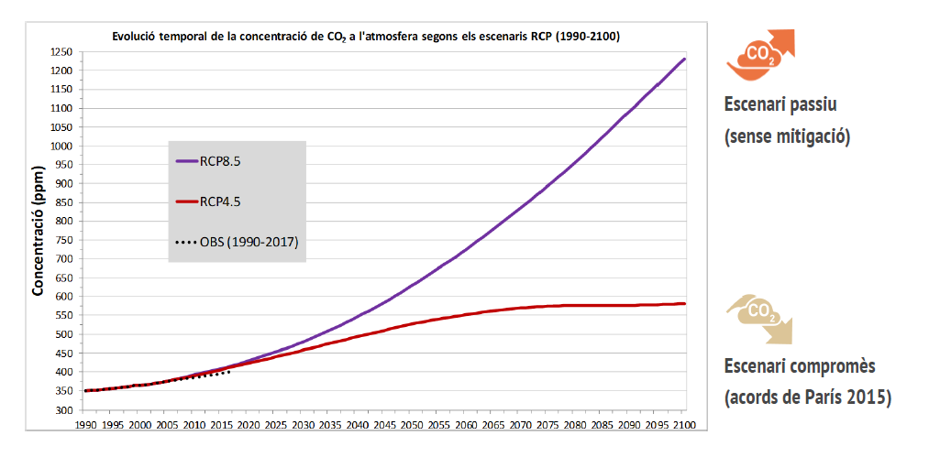
2. Projection of tramuntana patterns (2006-2100)
Passive scenario (without mitigation)
Compromised scenario (Paris agreement)

Slide 11
2. Projection of tramuntana patterns (2006-2100)
Monthly distribution of days with north wind:
observed vs. simulated (2006-2019)
Notes:
El número total de dies amb tramuntana a l’Empordà segueixen una distribució mensual semblant en els 9 models utilitzats i coherent amb la distribució obtinguda amb les dades de les estacions meteorològiques.
El regim estacional es Hivern – Primavera – Tardor – Estiu (HPTE) amb màxims al gener i al febrer.
Aquest regim es resultat de què les condicions sinòptiques durant la primavera i sobretot durant l’hivern són favorables a causar episodis de tramuntana.
La configuració sinòptica durant aquestes dos estacions és de tipus zonal (vent de l’oest), és a dir, la circulació de borrasques a l’Europa occidental se trasllada cap al sud afectant Catalunya.

Slide 12
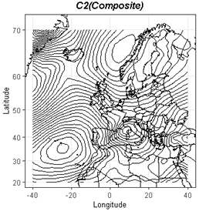
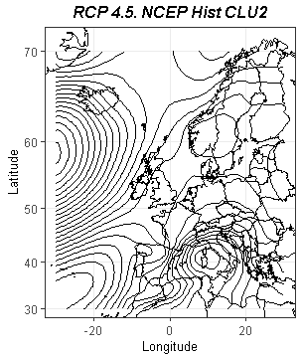
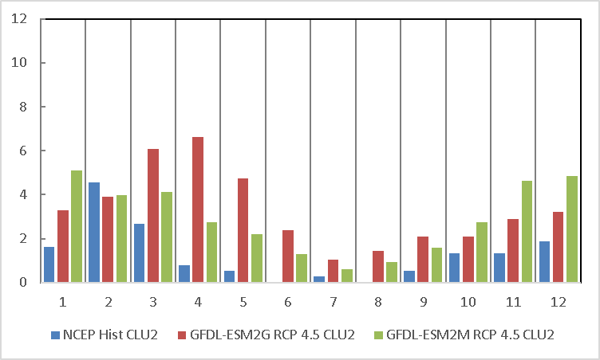
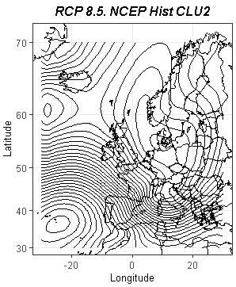
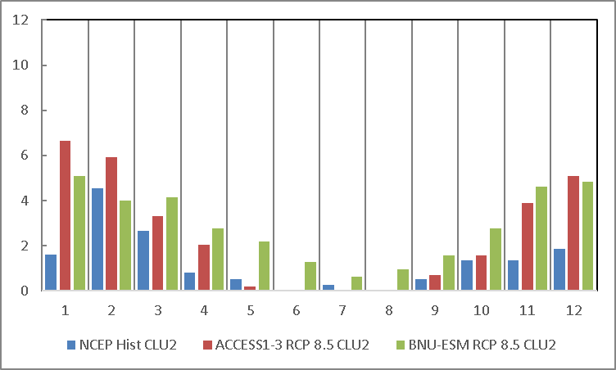
2. Projection of tramuntana patterns (2006-2100)
RCP 4.5
PATERN (C2) – Cyclonic north
RCP 8.5
Change in the seasonal regime in favour for AUTUMN

Slide 13
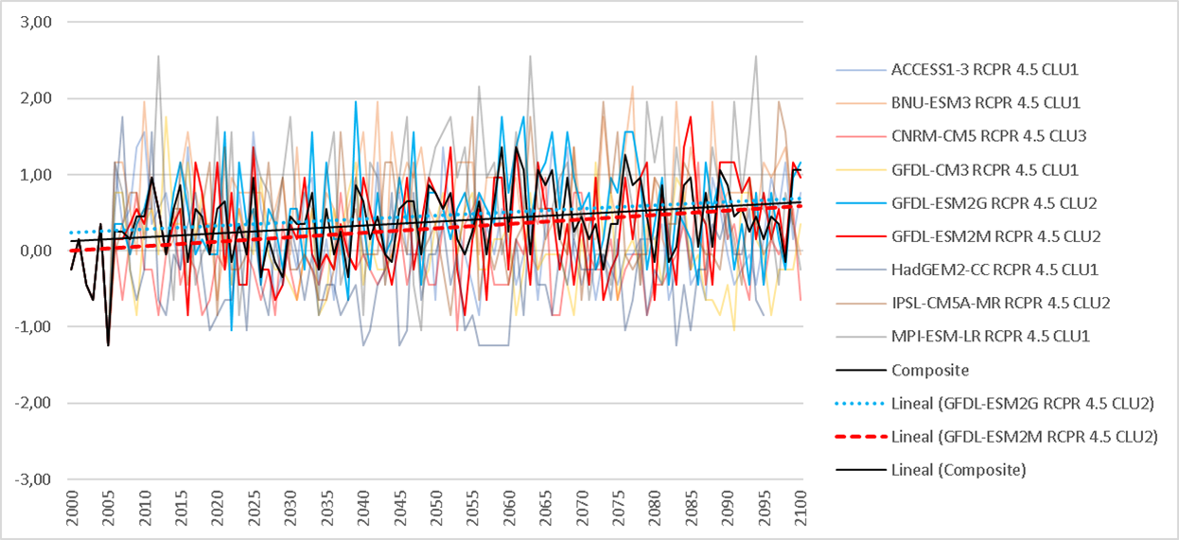
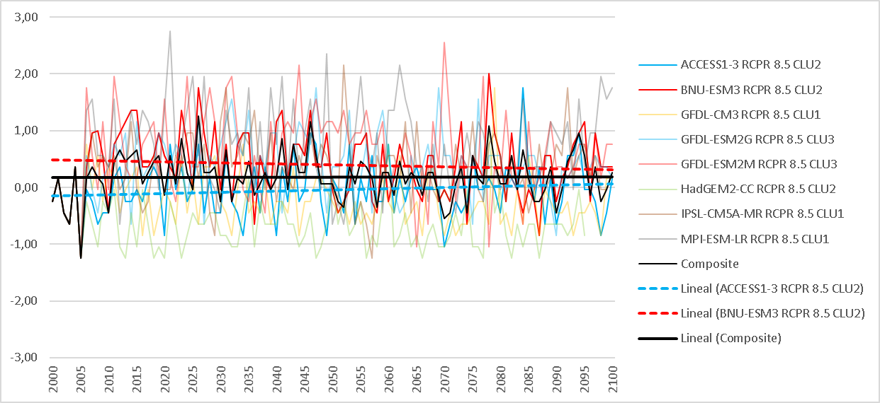
2. Projection of tramuntana patterns (2006-2100)
RCP 4.5
PATERN (C2) – Cyclonic north
RCP 8.5

Slide 14
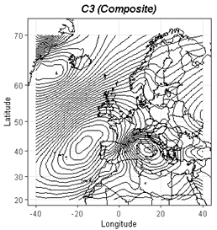
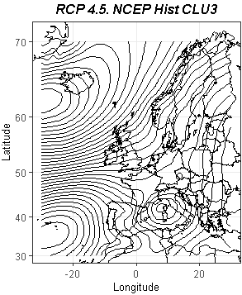
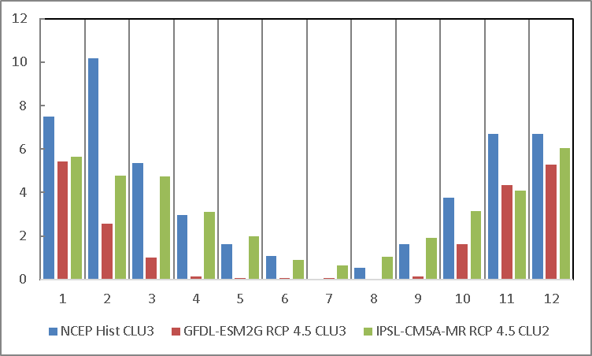
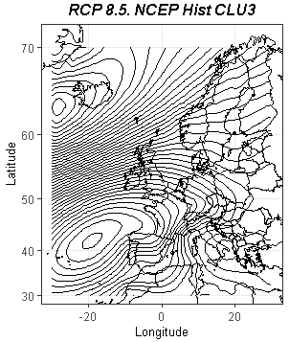
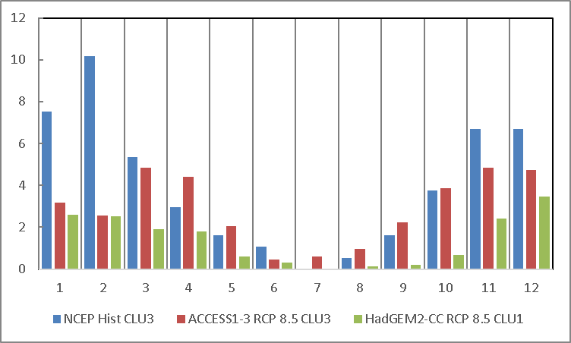
2. Projection of tramuntana patterns (2006-2100)
RCP 4.5
PATERN (C3) – North-east
RCP 8.5

Slide 15
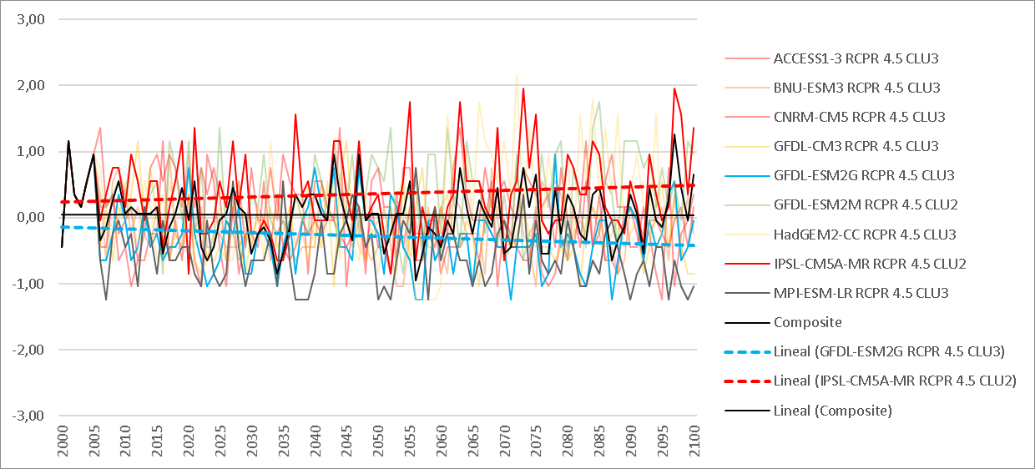
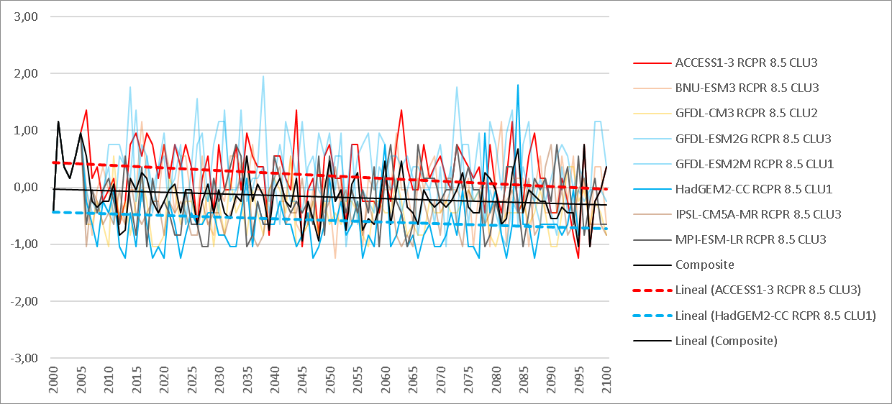
2. Projection of tramuntana patterns (2006-2100)
RCP 4.5
PATERN (C3) – North-east
RCP 8.5

Slide 16
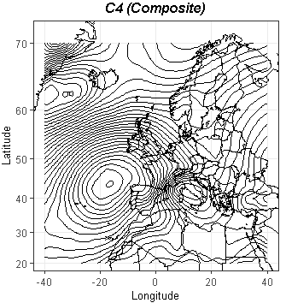
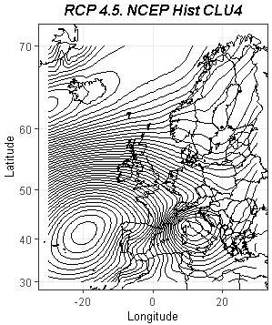
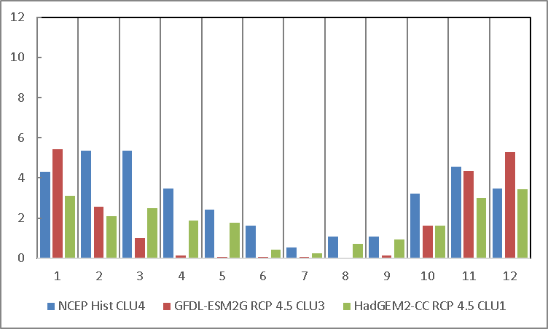
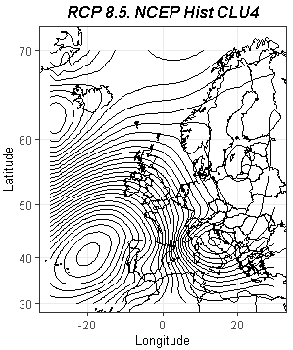
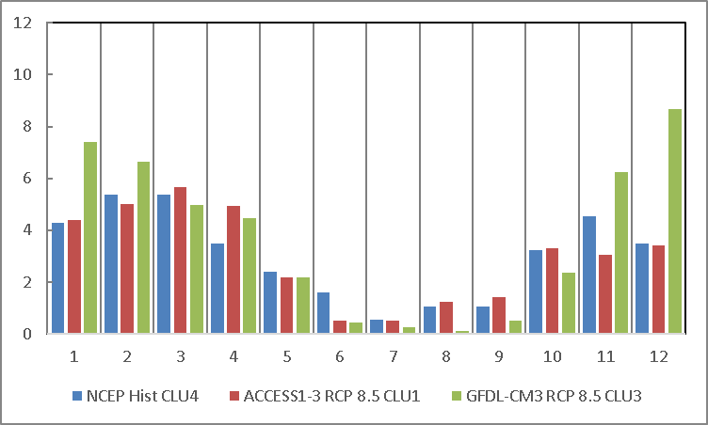
2. Projection of tramuntana patterns (2006-2100)
RCP 4.5
PATERN (C4) –Anticyclonic north
RCP 8.5

Slide 17
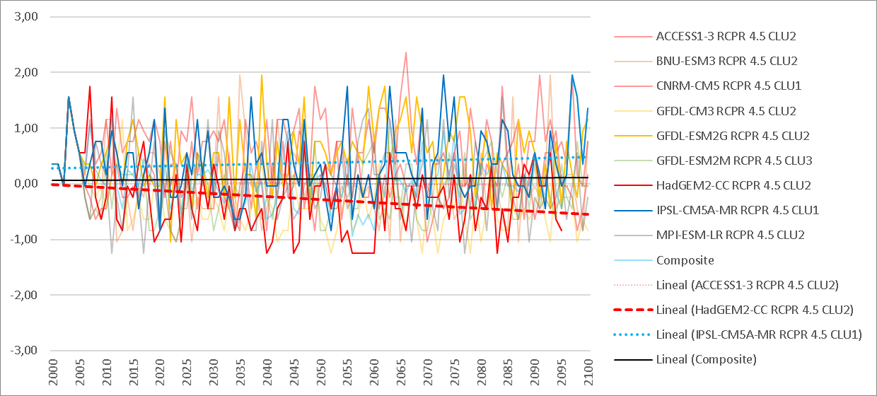
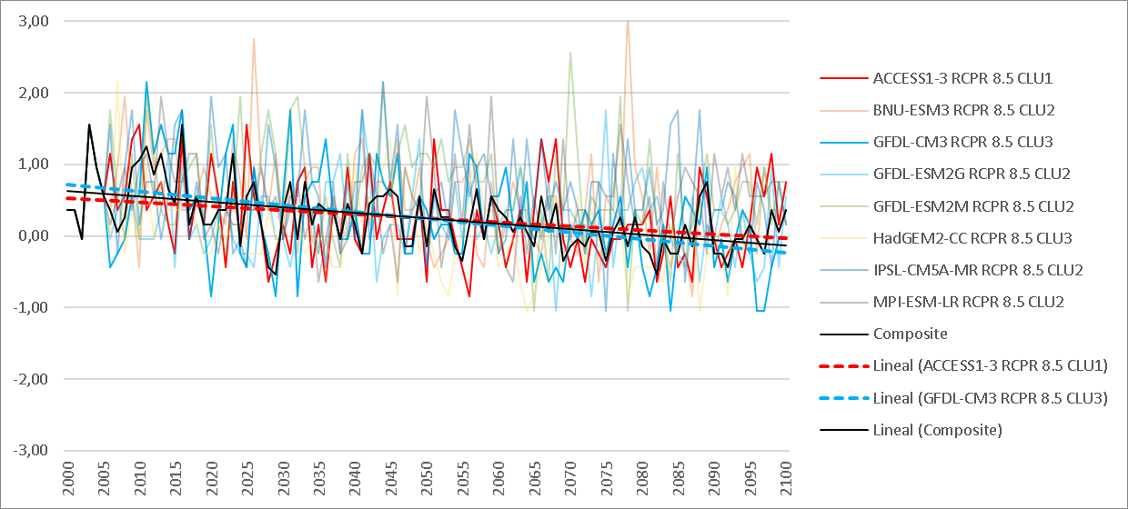
2. Projection of tramuntana patterns (2006-2100)
RCP 4.5
PATERN (C4) – Anticyclonic north
RCP 8.5

Slide 18
3. Conclusions
Tramuntana is a hegemonic wind in the Empordà region (1 of 3 days).
Obvious impact on water los due to ETo
3 synoptic patterns responsible for the north wind, winter regime.
The simulations (9 models, CMIP5) of the patterns in historical period capturate quite well observations.
Downward trend of northerly episodes in the RCP 8.5 scenario (most unfavorable scenario). In contrast, in CPR 4.5 the trend is almost zero.
Some change in the temporal pattern (RCP 8.5): a clear decrease in winter and an increase in spring (March and April) and, to a lesser extent, in autumn.

Slide 19
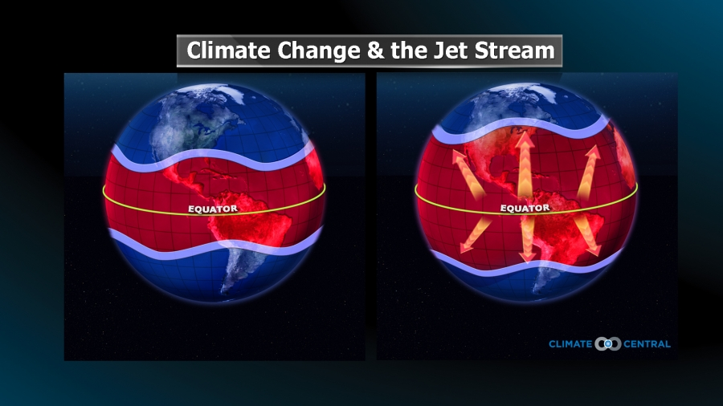
3. Conclusions
The reason: the increase in global temperature and a lower presence of jet stream. Paleo-climatic models have observed that during periods of warming in the northern hemisphere the jet stream moves to high latitudes, and vice versa when cooling occurs: migration of the jet stream to high latitudes, and the northern flows are less likely.

Slide 20


MANY THANKS!
Author: Fran Lorenzo

